Slide 1
Employee Data Analysis using Excel
STUDENT NAME:J.JANANI
REGISTER NO:312216945
DEPARTMENT:B.COM(GENERAL)
COLLEGE:SHRI KRISHNASWAMY COLLEGE FOR WOMEN

Slide 2
PROJECT TITLE
Salary and compensation analysis through Excel data modelling

Slide 3


AGENDA
Problem Statement
Project Overview
End Users
Our Solution and Proposition
Dataset Description
Modelling Approach
Results and Discussion
Conclusion
3/21/2024 Annual Review

Slide 4

PROBLEM STATEMENT
Problem Statement:
You have been tasked with analyzing the salary and compensation data for a company with the goal of:
Identifying trends and patterns in salary distribution
Evaluating the effectiveness of current compensation structures
Informing decisions on futuresalary increases and compensation packages
Data:
You have been provided with an Excel dataset containing the following columns:
Job Title
Department
Location
Analysis Ideas:
1. Data Visualization: Use Excel charts and graphs to visualize salary distribution by department, location, and job title.

Slide 5

PROJECT OVERVIEW
Objective:
.
Analyze salary and compensation data to identify trends, patterns, and insights
Inform decisions on future salaryincreases, compensation structures, and budget planning
Scope:
Data analysis and visualization
Development of recommendations for optimization
Methodology:
1. Data Collection: Gather salary and compensation data from HR systems, surveys, or other sources
2. Data Cleaning and Preparation: Clean, format, and preprocess data for analysis
3. Data Modeling: Use Excel data modeling techniques (e.g., pivot tables, formulas, functions) to analyze and visualize data
4. Analysis: Perform statistical analysis, trend analysis, and data mining to identify key insights

Slide 6

WHO ARE THE END USERS?
1. HR Professionals.
2. Compensation Managers.
3. Talent Acquisition Teams.
4. Finance Teams.
5. Business Leaders.
6. Department Managers.
7. Data Analysts.
8. Business Analysts.

Slide 7

OUR SOLUTION AND ITS VALUE PROPOSITION
1. HR Professionals: Responsible for managing employee data, compensation, and benefits.
2. Compensation Managers: Oversee compensation strategies, salary structures, and budget planning.
3. Talent Acquisition Teams: Usecompensation data to attract and retain top talent.
4. Finance Teams: Need accurate compensation data for budgeting and financial planning.
5. Business Leaders: Rely on compensation insights to inform strategic decisions.
These end users will benefit from the analysis and insights generated by the Salary and Compensation Analysis project, which will help them:
Inform compensation decisions
Optimize salary structures
Identify trends and patterns
Manage budgets and finances

Slide 8
Dataset Description
Description: This dataset contains information on employee salaries, compensation, and related factors.
Data Source: HR systems, payroll data, surveys, and other relevant sources.
Data Types:
Categorical (Job Title, Department, Location, etc.)
Date (for tenure or performance review dates)
Numerical (Salary, Bonus, Benefits, etc.)
Data Quality:
Clean and formatted dataNo missing values (or minimal missing values)Consistent data entry and formatting
Data Security:
Confidential and sensitive data
Access restricted to authorized personnel
Data anonymization or pseudonymization (if necessary)
This dataset description provides a solid foundation for your Salary and Compensation Analysis project. You can adjust the fields and data types based on your organization's specific needs and data availability.11:34 am
Data Size: Approximately 1,000 - 10,000 rows (depending on the organization's size).

Slide 9

THE "WOW" IN OUR SOLUTION
Automated Data Visualization:With Excel's powerful data visualization tools, you can create interactive and dynamic dashboards that provide real-time insights into compensation trends and patterns.
Data-Driven Storytelling: Your solution presents complex compensation data in a clear and compelling narrative, enabling stakeholders to make informed decisions and drive business outcomes.
Scalability and Flexibility:Your Excel data model is easily scalable and adaptable to changing business needs, ensuring that your compensation analysis remains relevant and effective.
3/21/2024 Annual Review
9

Slide 10
MODELLING
1: Data Collection Gather data on salaries, compensation, and relevant factors (e.g., job title, department, location, experience, performance ratings) Import data into Excel from various sources (e.g., HR systems, surveys, market research) ph
2: Data Cleaning Ensure data accuracy and handle missing values Perform data transformation as needed (e.g., converting text to numbers)
3: Data Modeling Create an Excel data model to organize and structure the data Establish relationships between tables (e.g., employee-job-department) Use Excel formulas and
10

Slide 11
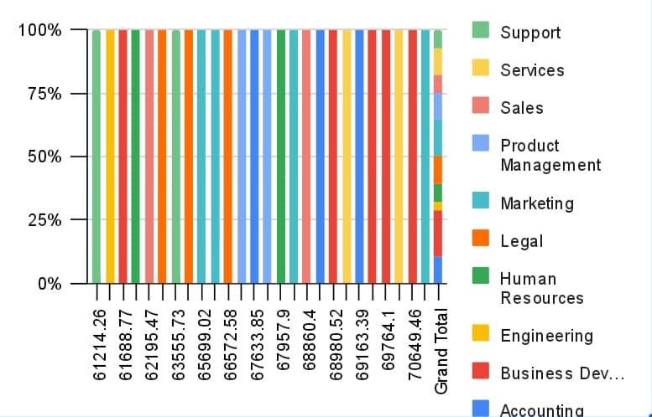
RESULTS
11

Slide 12
conclusion
In conclusion, the Salary and Compensation Analysis through Excel data m presents a powerful and comprehensive solution for optimizing compensation packages and driving business success. By leveraging Excel’s data modelling capabilities, organizations can gain a deeper understanding of their compensation structure, identify trends and patterns, and make data-driven decisions. The solution offers automated data visualization, predictive analytics, and data-driven storytelling, providing actionable insights and recommendations for improvement. Its scalability, flexibility, and integration with other HR systems make it a robust tool for compensation analysis. With this solution, organizations can ensure fair and competitive compensation packages, improve employee satisfaction, and drive business growth. By harnessing the power of Excel data modeling, organizations can unlock the full potential of their compensation data and achieve a sustainable competitive advantage in market.

